Slide 1
Re:defining the
future of business
W. P. Carey Annual Report

Slide 2
W. P. Carey Indigenous Land
Acknowledgment
The W. P. Carey School of Business acknowledges the 22 Tribal Nations that have inhabited this land for centuries. Arizona State University’s four campuses are located in the Salt River Valley on ancestral homelands of many Indigenous peoples, including the Akimel O’odham (Pima) and Pee Posh (Maricopa), whose care and keeping of these lands allows us to be here today and provides a guide for our relationship with these lands in the future. W. P. Carey acknowledges the sovereignty of these tribal nations and seeks to foster an environment of success and possibility for American Indian students, and to work alongside Indigenous people in business practices and knowledges that support Native experiences and prosperity.

Slide 3
Mission
By the numbers
Vision
W. P. Carey sparks positive change in business and society on a global scale by:
18,351
16,915
W. P. Carey
students
undergraduate
students
Educating students and growing talent to enrich and lead organizations
Producing groundbreaking and impactful research
Engaging actively with business, government, communities, and our campus
1,316
120
MBA and master’s students
doctoral
students
3,774
9,340
online
students
nonresident
students
6,211
1,771
We transform the world through access, excellence, and innovation in business knowledge. We are the W. P. Carey School of Business, where business is personal.
students from under-
represented populations
international
students
1,406
1,370
transfer
students
honors-level
undergraduate students

Slide 4
The Carey Code
I am a W. P. Carey Sun Devil:
I contribute to our legacy and live our values of excellence, integrity, impact, and community
I demonstrate that business is personal by treating others with respect and kindness
I advocate for diversity, equity, and inclusion to create stronger organizations and societies
I embrace and exhibit ethical business practices and lead others by example
I champion fellow Sun Devils and volunteer when and what I can to promote their success
And, together, we will spark positive change in the world, by doing good while doing well.

Slide 5
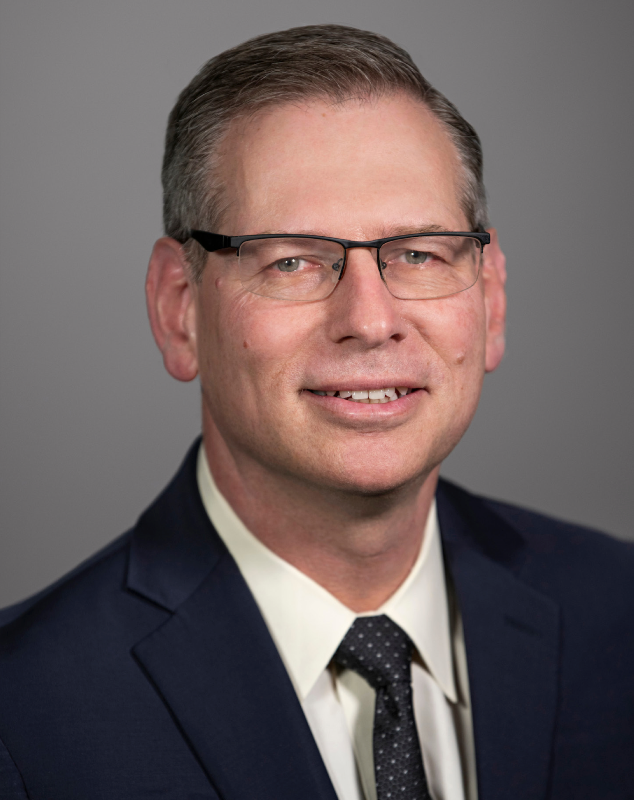
W. P. Carey’s Dean
Ohad Kadan, PhD
Charles J. Robel Dean
Professor and W. P. Carey Distinguished Chair
PhD: Finance, Hebrew University of Jerusalem
Research interests: Multidisciplinary collaboration, global business education, data-driven decisions

Slide 6
Developing our future
To nurture the next generation of innovators and to build on our foundation as a leading and growing business school, we must adapt to the demands of tomorrow — in the classroom, our service model, and our physical space. Establishing ourselves as pioneers in not only what we teach, but how we teach, will position the W. P. Carey School of Business as a leader within America’s most innovative university.
Our internationally renowned faculty represents six continents, bringing unique perspectives to their research and the classroom, setting the stage for where business goes next.

Slide 7
W. P. Carey core tenets
Our strategic planning aligns within and across the core tenets of the W. P. Carey School of Business:
Providing access to business education is foundational
We embrace modern technology in our curriculum and operations
We actively recruit, retain, and develop top talent
We seek excellence by pushing the frontier in our research and requiring world-class relevance and rigor in our classes
Entrepreneurship and innovation are key to our curriculum but also to how we deliver it
We are global in what we teach and where we operate
Values, ESG, and DEI are at the heart to what we do
We collaborate across disciplines
We actively engage with industries and communities
We do all of that while keeping a “business is personal” mindset

Slide 8
A foundation to redefine academic research
Academic departments
Interdisciplinary partners
School of Accountancy
Morrison School of Agribusiness
Department of Economics
Department of Finance
Department of Information Systems
Department of Management and Entrepreneurship
Department of Marketing
Department of Supply Chain Management
Barrett, The Honors College
College of Liberal Arts and Sciences
Watts College of Public Service and Community Solutions
Del E. Webb School of Construction
Herberger Institute for Design and the Arts
Ira A. Fulton Schools of Engineering
Julie Ann Wrigley Global Institute of Sustainability
Sandra Day O’Connor College of Law
Thunderbird School of Global Management
Walter Cronkite School of Journalism and Mass Communication

Slide 9
A foundation to redefine academic research
Research centers
Research labs
The Center for Advanced Procurement Strategy (CAPS)
The Center for Applied Research and Innovation in Supply Chain - Africa (CARISCA)
The Center for Competitiveness and Prosperity Research
The Center for Entrepreneurship
The Center for Environmental Economics and Sustainability Policy
The Center for Investment Engineering
The Center for Real Estate Theory and Practice
The Center for Services Leadership (CSL)
The Center for the Study of Economic Liberty
The JP Morgan Chase Economic Outlook Center
The L. William Seidman Research Institute
Actionable Analytics Lab
Complex Adaptive Supply Networks Research Accelerator (CASN-RA)
Digital Society Initiative
Food and Agribusiness Lab (FAB Lab)
Frontier Economies Logistics Lab
Health Sector Supply Chain Research Consortium (HSRC-ASU)
Internet Edge Supply Chain Lab
Robert B. Cialdini Behavioral Research Lab
Supply Chain Management Behavioral Lab

Slide 10
ASU’s W. P. Carey School of Business
Founded in 1955
Named in honor of our benefactor, the late investor and philanthropist Wm. Polk Carey
One of the largest and highest-ranked business schools in the United States, with campuses in Arizona, California, and Shanghai
More than 120,000 alumni worldwide
31 programs and disciplines ranked Top 25 by U.S. News & World Report – the most of any business school in the U.S.

Slide 11
*Data from 2021 ASU Annual Report
No. 1 in Innovation for seven years running (U.S. News & World Report)
$1 billion+ in external funding for ASU’s Skysong Innovations startups
No. 6 in the U.S. for total research expenditures among universities without a medical school (National Science Foundation HERD Survey, 2019)
No. 1 university in the U.S. for global impact in addressing the United Nations Sustainable Development Goals in research, outreach and stewardship in 2021 (Times Higher Education)
In North America’s greenest colleges and universities, ASU ranks No. 1 on Sierra magazine’s 15th annual “coolest schools” competitive ranking, ahead of UC Berkeley, Penn State, UCLA and Yale.

Slide 12
ASU Charter
ASU is a comprehensive public research university, measured not by whom it excludes, but by whom it includes and how they succeed; advancing research and discovery of public value; and assuming fundamental responsibility for the economic, social, cultural and overall health of the communities it serves.

Slide 13
W. P. Carey Programs
Undergraduate
Bachelor’s Degrees:
Accountancy, BS
Business administration, BA
Business data analytics, BS
Business entrepreneurship, BS
Communication, BA
Computer information systems, BS
Corporate accounting, BA
Economics, BS
Economics and engineering
management, BS, BSE*
Finance, BS
Financial planning, BA
Food industry management, BA
Global agribusiness, BA
Global leadership, BA
Global logistics management, BA
Global logistics management and international trade, BS, BA*
Global politics, BA
Health care, BA
Human resources, BA
Information security, BA
Language and culture, BA
Law, BA
Management, BS
Marketing, BS
Communication
Digital and Integrated Marketing Professional Sales
Public service and public policy, BA
Retail management, BA
Sports business, BA
Statistics, BA
Supply chain management, BS
Supply chain management and sustainability, BS, BA*
Sustainability, BA
Technology, BA
Tourism, BA
Minors:
Business
Real Estate
* Concurrent degrees
*** Degree partnership with Ira A. Fulton School of Engineering and the Herberger Institute for Design and the Arts
**** Dual degree partnership with Tecnológico de Monterrey/ EGADE Business School

Slide 14
W. P. Carey Programs
Graduate
Master’s of Business Admin (MBA):
Evening MBA
Executive MBA
Full-time MBA
Online MBA
Specialized Master’s Degrees:
Master of Accountancy and Data Analytics (MACC)
MACC in Los Angeles
Master of Science in Business Analytics
(MS-BA)
Online MS-BA
MS-BA in Los Angeles
Master of Science in Finance
Master of Science in Global Logistics
Master of Science in Information
Science Management
Master of Science in Innovation and
Venture Development***
Master of Science in Management
Master of Real Estate Development
Online Master of Science in Supply
Chain Management
Master of Taxation and Data Analytics
Degrees offered internationally:
Executive MBA (China)
EGADE — W. P. Carey Executive MBA (Mexico)****
Doctor of Business Administration (China)
Master of Science in Management (China)
* Concurrent degrees
*** Degree partnership with Ira A. Fulton School of Engineering and the Herberger Institute for Design and the Arts
**** Dual degree partnership with Tecnológico de Monterrey/ EGADE Business School

Slide 15
W. P. Carey Programs
Doctorate
PhD in Business Administration:
Accountancy
Agribusiness
Finance
Information systems
Management
Marketing
Supply chain management
PhD in Economics
A commitment to a small, tight-knit community. The resources of America’s largest university. World-renowned faculty whose research reframes the way we think about business. Each year, the W. P. Carey School of Business welcomes thousands of students from nearly 100 countries. Their diversity, passion, and global thinking will drive new ideas for decades to come.
To meet the demands of our students and the marketplace, we constantly evaluate and introduce degree options and flexible formats to ensure that a quality business education is always within reach. And we leverage ASU’s approach to interdisciplinary education, tapping into the expertise of schools and colleges across the New American University — engineering, law, design, communication, sustainability, and more.

Slide 16
Corporate partners
and initiatives
Leveraging partnerships with the world’s top companies across industries, the W. P. Carey School and ASU have developed degree and non-degree programs rooted in business fundamentals and emerging trends, with a focus on flexibility to meet learners where they are.

Slide 17
Innovative partnerships
The W. P. Carey School of Business works alongside ASU and corporate partners to expand on our vision of rethinking the nature of business. Through key partnerships and long-term initiatives, we are dedicated to meeting learners where they are — in their career and their life.
Salt River Project
A credit-bearing, three-course program focusing on MBA foundation curriculum (Financial Accounting, Organizational Behavior, and Sources of Competitive Advantage) that can be taken as a stand-alone program and can be leveraged as a pathway to a full MBA program.
The program is delivered as a hybrid modality where classes take place synchronously in a remote environment through Zoom, supported by an online course shell.

Slide 18
Innovative partnerships
The W. P. Carey School of Business works alongside ASU and corporate partners to expand on our vision of rethinking the nature of business. Through key partnerships and long-term initiatives, we are dedicated to meeting learners where they are — in their career and their life.
Cognizant
To meet its growing demand for business analysts, Cognizant Consulting has partnered with ASU and the W. P. Carey School of Business to offer the Cognizant Digital Business Analyst Certificate Program, a train-to-hire program. The curriculum
focuses on specific skills needed to succeed at Cognizant, and ensures the opportunity to secure an interview for graduates. 90% of students who completed this program in spring 2019 received an offer to join Cognizant as business analysts.

Slide 19
Innovative partnerships
The W. P. Carey School of Business works alongside ASU and corporate partners to expand on our vision of rethinking the nature of business. Through key partnerships and long-term initiatives, we are dedicated to meeting learners where they are — in their career and their life.
Chemonics
MiniMaster’s in Leadership and Management: A three-course management and leadership program tailored to the unique needs of a large international aid development organization that operates in over 90 countries worldwide. The program’s courses focus on leading change, project leadership, and designing/leading teams, and are delivered asynchronously online. The courses, which have been specifically designed and are taught by W. P. Carey faculty, include guest lectures from a range of faculty members, expert contributors, reflections, and panels from our
partner’s leadership team to provide program participants broad perspectives on management and leadership, which is incredibly important since participants hail from diverse backgrounds from the U.S. and around the world. The program is offered as a non-credit professional credential with the option to convert coursework for credit into designated ASU graduate programs. In 2020, the W. P. Carey School and its partner successfully concluded a fourth cohort of a similar employee program focused on Supply Chain Management, the MiniMaster’s in Supply Chain Management.

Slide 20
Innovative partnerships
507
The W. P. Carey School of Business works alongside ASU and corporate partners to expand on our vision of rethinking the nature of business. Through key partnerships and long-term initiatives, we are dedicated to meeting learners where they are — in their career and their life.
There have been 507 Starbucks College Achievement Plan graduates from W. P. Carey.
Starbucks
W. P. Carey is proud to play a role in Starbucks’ innovative partnership at ASU, including the Starbucks College Achievement Plan, the ASU-Starbucks Center for the Future, Starbucks Global Academy, and other innovative business solutions, such as corporate business programs. One such collaboration is a
non-credit-bearing, professional development workshop delivered remotely via Zoom that focuses on strategic decision framing and delivery through programming that blends concepts from strategy and data analytics to more rapidly and inclusively arrive at decisions of impact and value for our corporate partner.

Slide 21
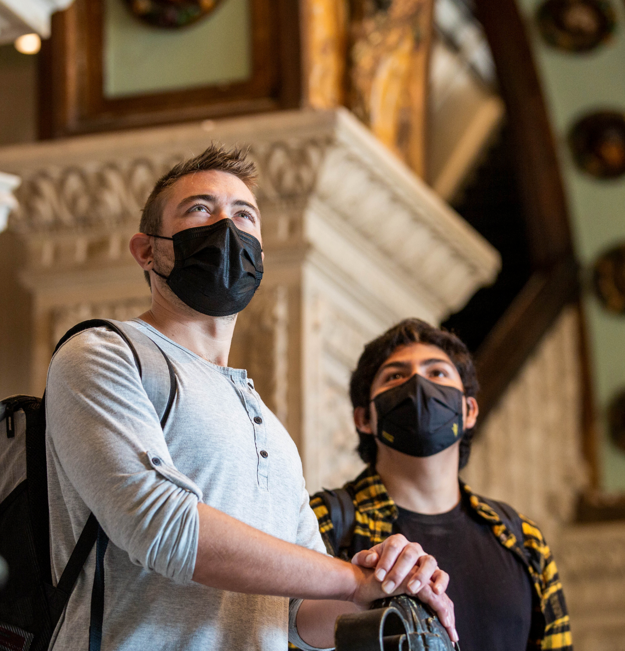
Key initiatives
ASU in LA
ASU has been deeply connected to California for many years, working with educational, non-profit, and business partners. The university now has a new home, the ASU California Center in downtown Los Angeles, located at the historic Herald Examiner Building.
california.asu.edu

Slide 22
Key initiatives
ASU in LA
The U.S. Department of Labor awarded Arizona State University an $8 million grant to lead an innovative workforce development partnership to help train workers for high-paying, high-demand jobs in advanced manufacturing, cybersecurity, and information technology.
wpcarey.asu.edu/aznext
A community initiative
The AZNext Program is a groundbreaking collaboration between the W. P. Carey School of Business and these partners.
Ira A. Fulton Schools of Engineering
New College of Interdisciplinary Arts and Sciences
Arizona Commerce Authority
Arizona Technology Council
Arizona@Work
Infosys
Pipeline AZ

Slide 23
Recognizing excellence
At the W. P. Carey School of Business, we take immense pride in the longstanding quality of our programs and the groundbreaking
accomplishments of W. P. Carey students and alumni. And with more than 50 ways to earn a W. P. Carey degree, we’re preparing the leaders of tomorrow for wherever their career takes them.

Slide 24
Highly ranked programs
Academic programs
U.S. News & World Report
#1 | For best online undergraduate business programs
#4 | For best online MBA programs for veterans
#5 | For highest return on investment, Full-time MBA programs
#7 | For best online graduate business programs
#7 | For best online MBA programs
#13 | For best executive MBA programs
#18 | For best part-time MBA program
#23 | For best undergraduate business programs
#29 | For best full-time MBA programs

Slide 25
Highly ranked programs
Academic programs
Princeton Review
#1 | For best operations MBA
#6 | For greatest resources for minority students
#11 | For best online MBA programs
#9 | For best executive MBA worldwide (EMBA in Shanghai)
#15 | For best online MBA worldwide
#23 | For best full-time MBA in the U.S.
#23 | For best executive MBA worldwide
#4 | For best executive MBA in the U.S.
#34 | For best full-time MBA in the U.S.
Financial Times
The Economist
Poets & Quants

Slide 26
Highly ranked programs
Undergraduate programs
#2 | For best undergraduate supply chain and logistics program
#5 | For best undergraduate analytics program
#7 | For best undergraduate production/operations management program
#9 | For best undergraduate management information systems program
#10 | For best undergraduate quantitative analysis program
#11 | For best undergraduate accounting program
#11 | For best undergraduate marketing program
#15 | For best undergraduate management program
#16 | For best undergraduate international business program
#19 | For best undergraduate finance program
#32 | For best undergraduate entrepreneurship program
U.S. News & World Report

Slide 27
Highly ranked programs
MBA specialties
U.S. News & World Report
#2 | For best online business analytics MBA programs
#2 | For best online marketing MBA programs
#2 | For best business school project management MBA program
#3 | For best online finance MBA programs
#3 | For best online general management MBA programs
#3 | For best business school supply chain and logistics MBA program
#11 | For best business school information systems MBA program
#13 | For best business school business analytics MBA program
#14 | For best business school accounting MBA program
#16 | For best business school management MBA program
#16 | For best business school production/operations MBA program
#20 | For best business school international MBA program
#20 | For best business school marketing MBA program
#23 | For best business school entrepreneurship MBA program

Slide 28
Highly ranked programs
Academic subjects
Academic Ranking of World Universities
#9 | For management programs
#12 | For business administration programs
#23 | For economics programs
#26 | For finance programs

Slide 29
Highly ranked programs
Research
Association for Information Systems Research Rankings
#4 | For the Information Systems department ranking world wide research, 2016-2021
#3 | For the Management department research productivity, five-year total
#26 | For research productivity, worldwide
Texas A&M/University of Georgia Management Research Rankings
Poets & Quants
No. 30
The W. P. Carey School ranks No. 30 for best business school full-time MBA program by U.S. News & World Report, ahead of University of Notre Dame, The Ohio State University, and Pennsylvania State University.

Slide 30
No. 1
W. P. Carey School of Business ranks No. 1 for online undergraduate business programs by U.S. News & World Report, ahead of University of Massachusetts, the University of Arizona, and University of Illinois—Chicago.

Slide 31
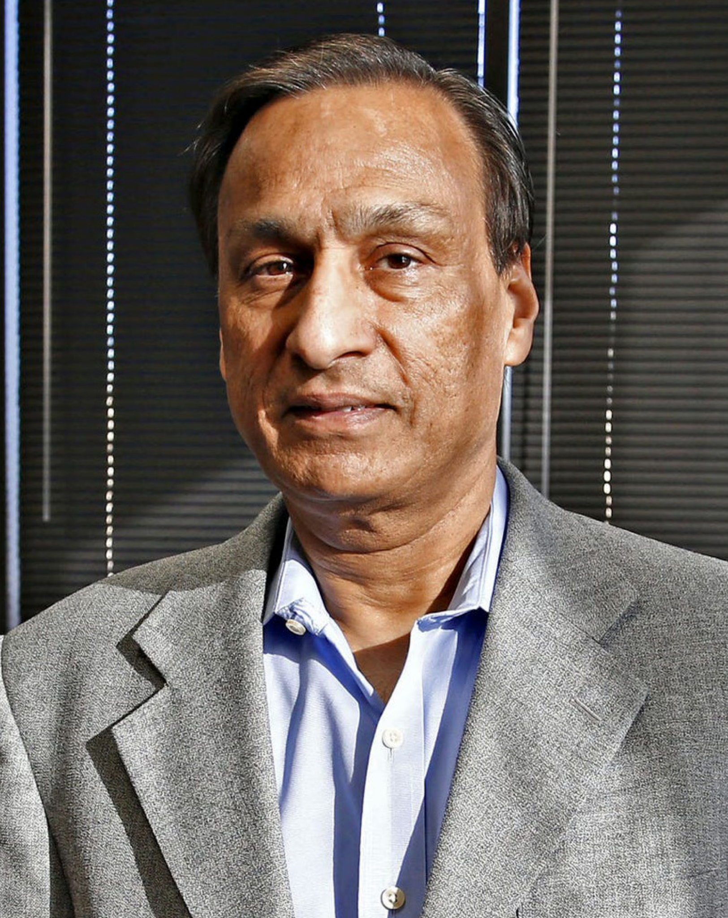
Celebrating our community
Executive of the Year
Greatness in business comes with extensive experience, commitment, and perseverance. W. P. Carey is proud to recognize the excellence of leaders from the local, national, and international business communities.
Steve Sanghi
Executive chair, Microchip Technology Inc.
The W. P. Carey School’s Dean’s Council honors one business leader annually whose contribution is recognized as significant to the nation and the world, whose inspired leadership has created and sustained superior organizational performance, and whose achievements exemplify a model for future business leaders.

Slide 32
Economic Club of Phoenix
2021 – 22 speakers:
Lead. Inform. Influence.
The Economic Club of Phoenix (ECP) enhances discussion of economic and business issues among academic, business, labor, and public sectors in the Phoenix area.
Joshua LaBaer
Executive Director and Professor,
ASU Biodesign Institute
Rebecca Clyde
CEO and Co-founder,
Botco.ai
Dallas Tanner
CEO,
Innovation Homes
Tom Harris
Executive Vice President and Chief
Financial Officer,
Arizona Diamondbacks

Slide 33
Spirit of Enterprise Award
2021 award winner: Botco.ai
The Spirit of Enterprise Award is Arizona’s premier celebration of entrepreneurship. For more than two decades, the W. P. Carey School has recognized businesses that positively impact our economy while exhibiting ethics, energy, and excellence in entrepreneurship.
Botco.ai is a HIPAA-compliant, intelligent chat solution that instantly answers patient questions. Using Botco.ai, providers can automate conversations, capture 103% more appointments, and access conversational insights that improve the patient experience.

Slide 34
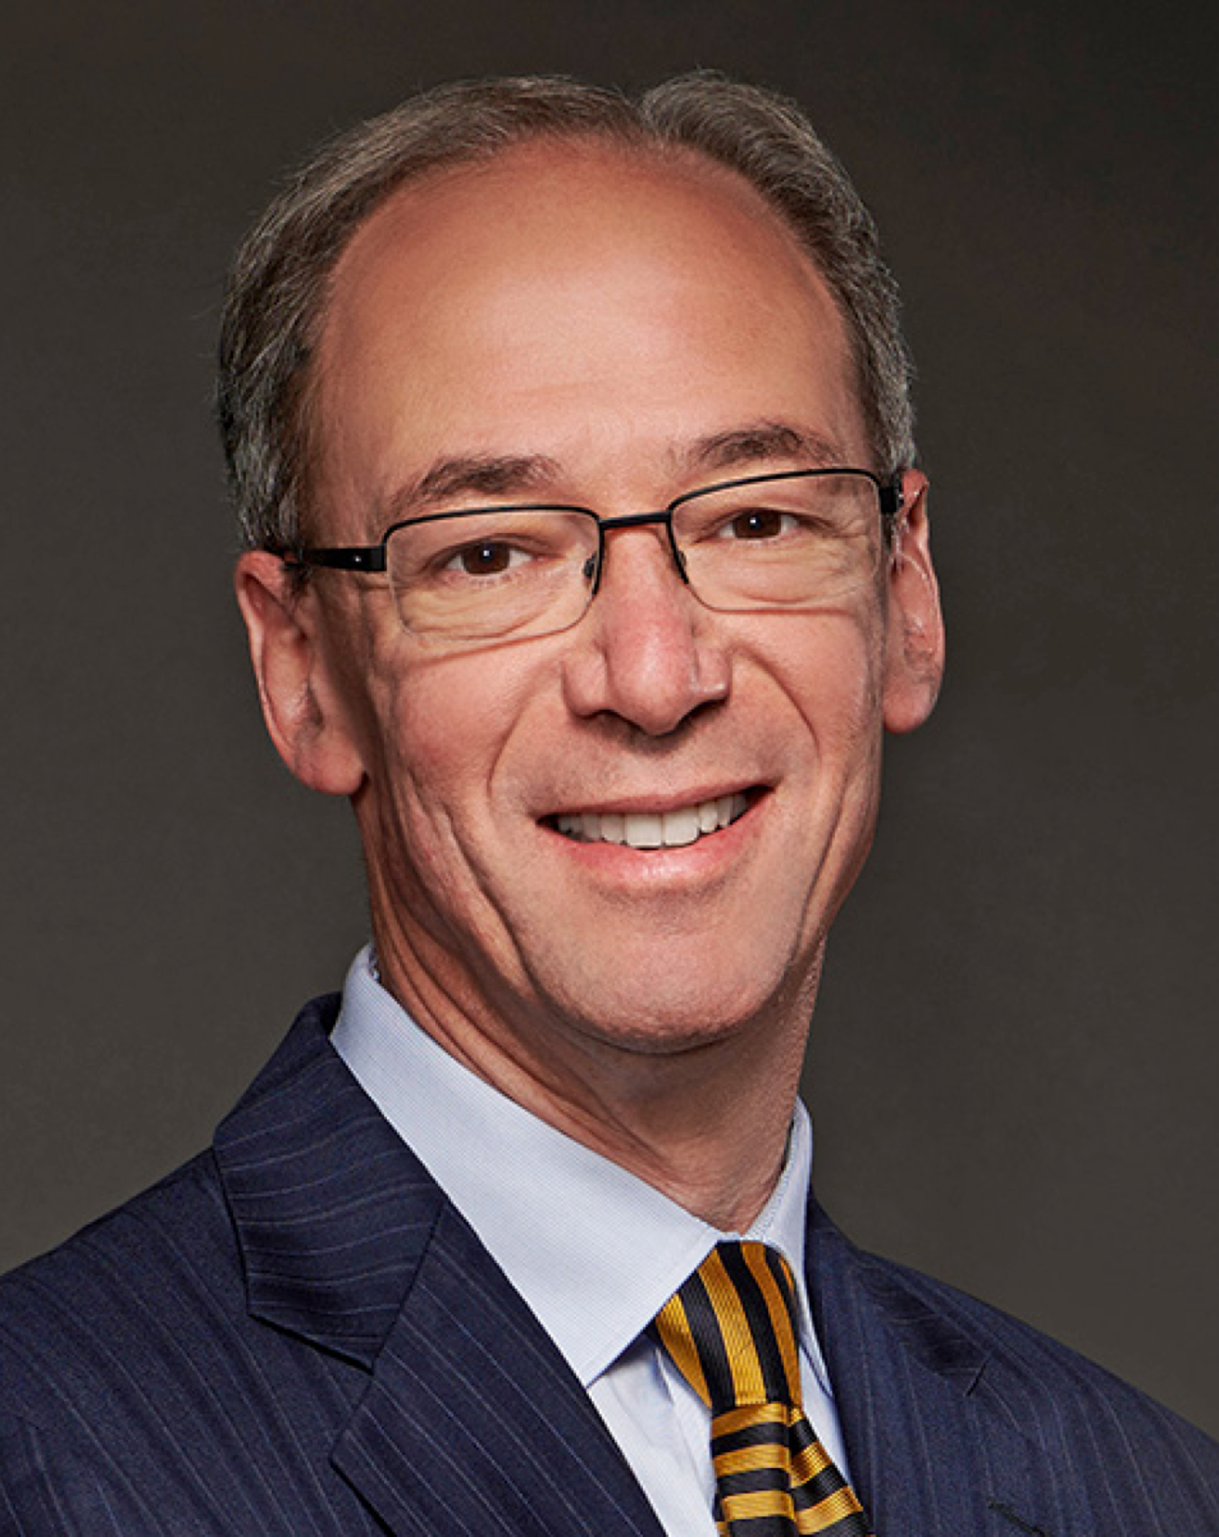
Lawrence R. Klein Award
2021 award winner: Carl Tannenbaum
An annual honor for economic forecasting accuracy, the W. P. Carey School of Business presents the Lawrence R. Klein Award in association with the nationally recognized Blue Chip Economic Indicators newsletter.
Carl Tannenbaum is the Chief Economist for Northern Trust. In this role, he briefs clients and colleagues on the economy and business conditions, prepares the bank’s official economic outlook, and participates in forecast surveys. Tannenbaum is also responsible for the analytics and modeling group within Northern Trust’s risk management division, and is a member of the bank’s capital committee, its investment policy committee, and the asset/liability management committee. Prior to joining Northern Trust, Tannenbaum spent four years at the Federal Reserve.

Slide 35
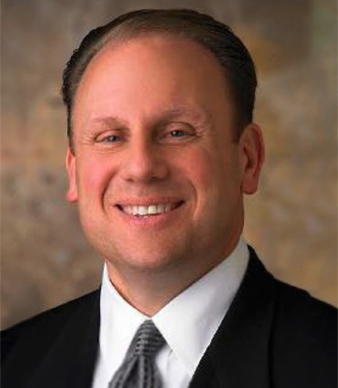
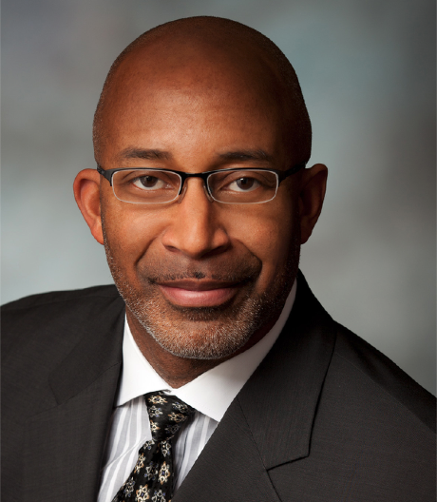
W. P. Carey Alumni Hall of Fame
Edward N. “Trey” Basha III
Kimberly A. Komando
Charles A. Wilhoite
Nicole Wood
Chairman of the Board, President, and CEO,
Bashas’ Inc.
MBA ’02
Founding Partner, WestStar Multimedia Network
Host, The Kim Komando Show
BS Information Systems ’85
Managing Director, Willamette Management Associates
BS Accountancy/Finance ’87
CEO and Co-founder,
Ama La Vida
BS Finance/Supply Chain Management ’11

Slide 36
Student success
Undergraduate
Top industries
Featured employers
Internet and software
Accounting
Commercial banking and credit
ADP LLC
Amazon.com Inc.
Arizona State University
Charles Schwab Corp.
Cisco Systems Inc.
CVS Health Corp.
Deloitte
DriveTime Automotive Group Inc.
Enterprise Holdings Inc.
EY LLP
The Goldman Sachs Group Inc.
Honeywell International Inc.
Intel Corp.
JPMorgan Chase & Co.
KPMG US LLP
Microsoft Corp.
Morgan Stanley
MUFG
PepsiCo Inc.
Renaissance Financial Corp.
Starbucks Corp.
State Farm Life Insurance Co.
TEKsystems Inc.
The Vanguard Group Inc.
Wells Fargo & Co.

Slide 37
Student success
Full-time MBA
$134,955
97%
average salary
Includes base salary and
signing bonus
average salary
Includes base salary and
signing bonus
Top industries
Featured employers
Technology
Manufacturing
Financial services
Consulting
Amazon.com Inc.
Applied Materials
Bank of America Corp.
Dell Inc.
Honeywell International Inc.
Intel Corp.
KPMG US LLP
Raytheon Co.

Slide 38
Student success
Alumni
118,033
170+
5,604
total alumni
ASU alumni chapters around the world
“Double Devils” aka people who got their undergraduate and graduate degrees from W. P. Carey

Slide 39
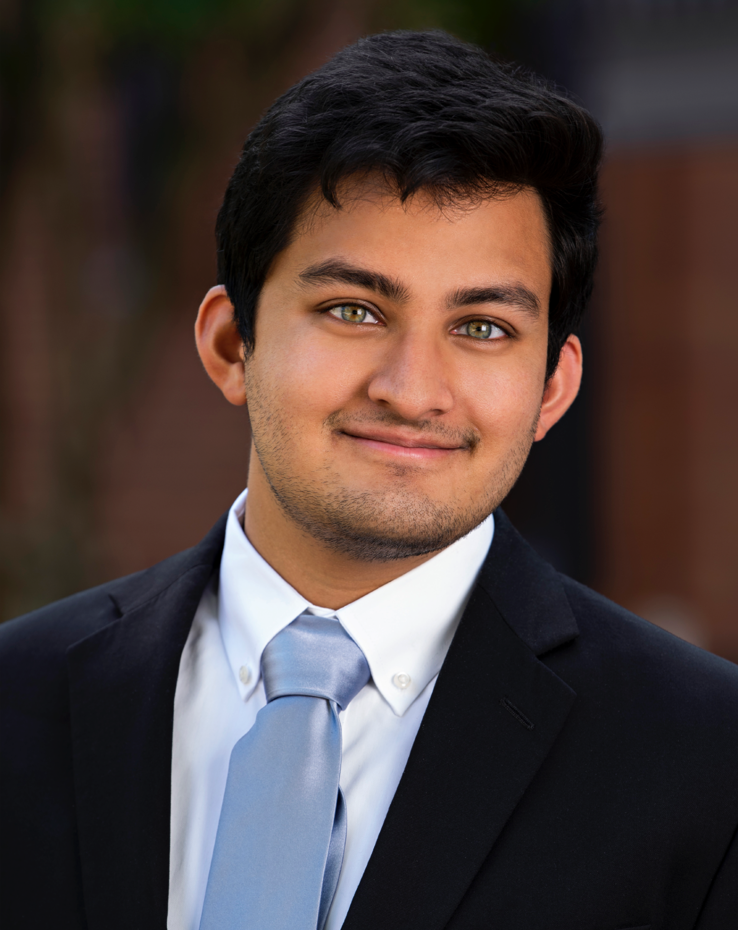
A lesson I have seen displayed first hand at ASU is the power of individual action.
Shakki Bhat
Business Global Politics,
Supply Chain Management ’21
“I have met tons of amazing people making a difference in their communities, many of whom are my age or younger. I have seen students work on projects that provide education to refugees, micro-financing to small businesses, and platforms for underrepresented groups to have their voices heard. They have taught me that instead of waiting for change to occur, we have the power to make a difference in our own communities through our everyday actions.”

Slide 40
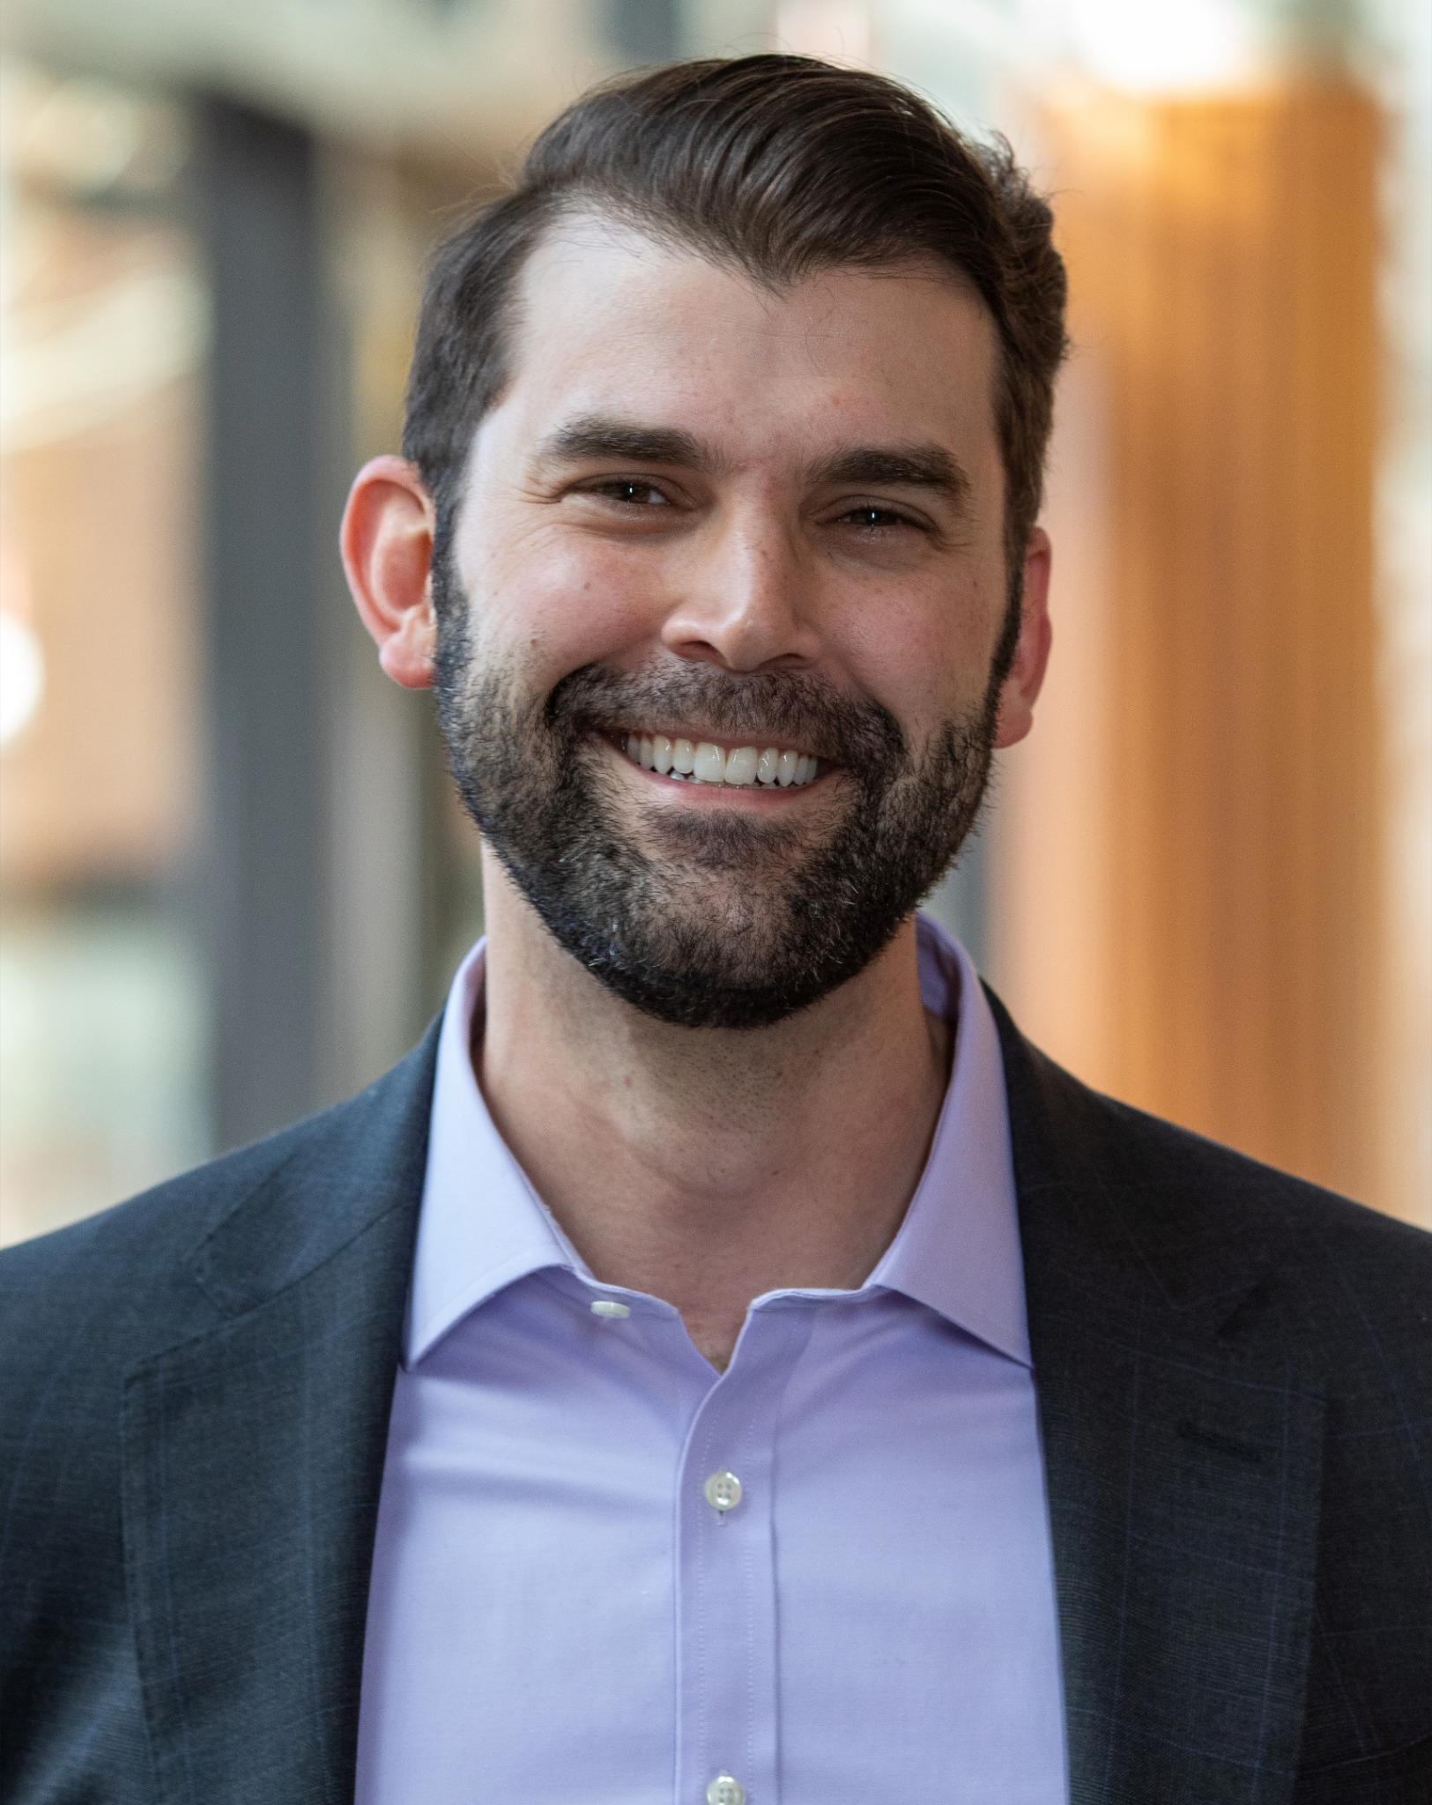
W. P. Carey taught me how to tackle problems from several perspectives at once.
Matthew Totlis
MBA ’21
“I majored in math in college, and although I absolutely loved it, mathematicians tend to believe that there’s one singular way to solve a problem. W. P. Carey taught me how to tackle problems from several perspectives at once, and once you’ve learned that method, you start to apply it to everything you do.”

Slide 41
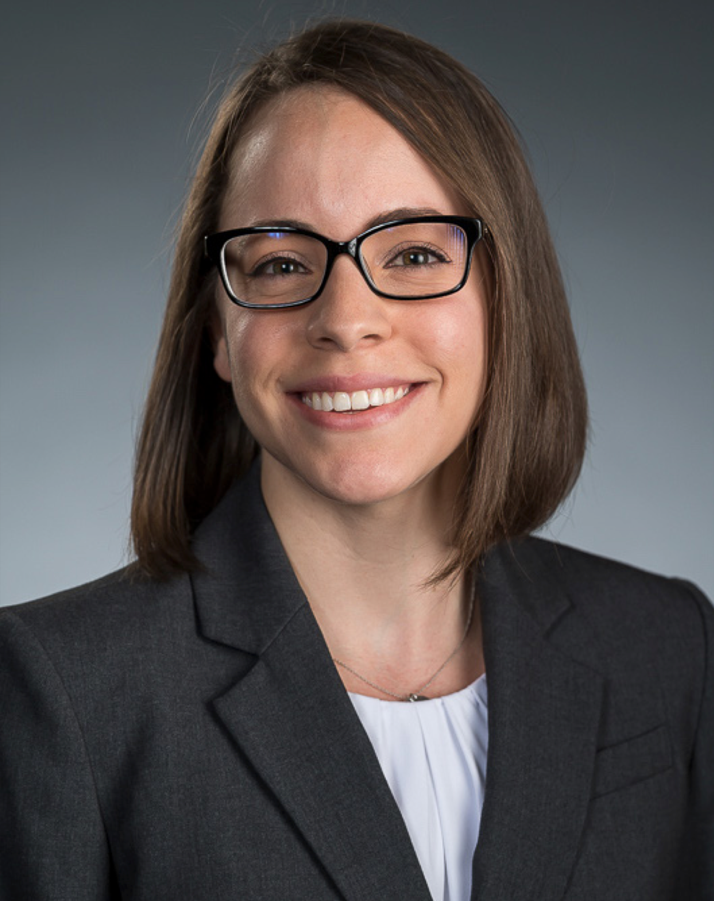
We have small, intimate cohorts compared to most other top MBA programs, while having the vast resources of the country’s largest university at our fingertips.
Denise Napolitano
MBA ’20
“Students are encouraged to embrace the school’s entrepreneurial spirit and to take the opportunity to craft our futures with a flexible and multidisciplinary curriculum.”

Slide 42
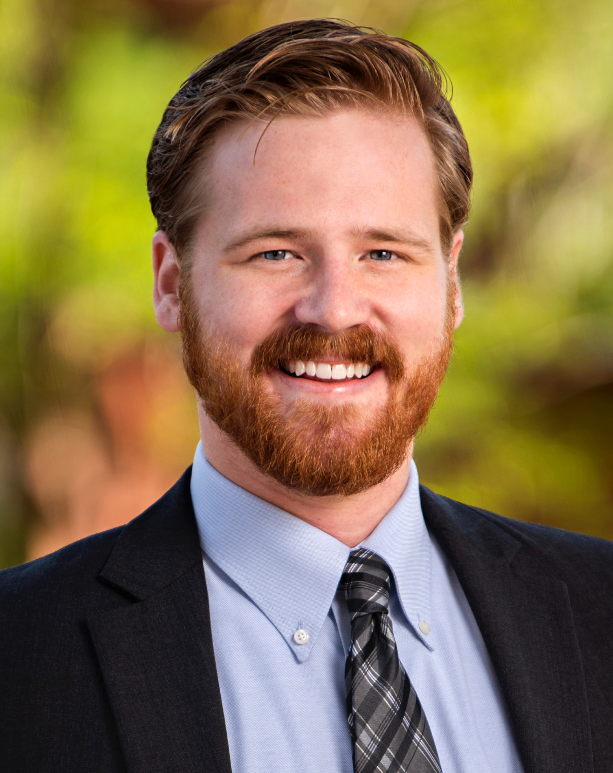
I have been impressed with the accessibility of the professors and how they really care for students.
Nathan Consalvo
Business Management,
Supply Chain Management ’21
“Coming from a small high school, I was impressed with the resources available at a large university like ASU, such as research opportunities, study abroad trips, and mentor networks. I am incredibly happy I chose ASU and know it was the right choice for me.”

